Slide 1

2020 Best Places to Work in the Federal Government®
Social Media Toolkit
Tuesday, June 29, 2021
#FedBPTW

Slide 2
OVERVIEW
On Tuesday, June 29, the nonprofit Partnership for Public Service and global management consulting firm Boston Consulting Group will honor the top-ranked and most improved federal agencies and subcomponents included in the 2020 Best Places to Work rankings. The Best Places to Work in the Federal Government rankings offer the most comprehensive assessment of how federal public servants view their jobs and workplaces.
The rankings provide employee perspectives on leadership, pay, innovation, work-life balance, and a range of other issues. For a complete list of the 2020 rankings and accompanying data visit: https://bestplacestowork.org/.
This document includes sample report amplification social media posts and graphics for agencies, agency leadership, members of congress, and federal employees. When posting about the rankings, please tag both the Partnership and Boston Consulting Group.

Slide 3



FOLLOW US
@Partnershipforpublicservice
@rpublicservice
@PublicService
#
#FedBPTW

Slide 4
FOLLOW US
@BostonConsultingGroup
@bcg
@bcg
#
#FedBPTW

Slide 5
Sample Social Media Posts for Agencies

Slide 6
TWITTER
Today, @PublicService and @BCG released the 2020 Best Places to Work in the Federal Government rankings! Check out where we ranked in this year's #FedBPTW at bestplacestowork.org.
.@publicservice and @BCG listed our agency among the top-ranked agencies in the 2020 #FedBPTW! Thank you to everyone who contributes to our great culture and made this recognition possible. Visit bestplacestowork.org to see the rest of the list.
We are proud to be ranked in the top 10 of the 2020 Best Places to Work in the Federal Government! Check out the full #FedBPTW rankings from @publicservice and @BCG at bestplacestowork.org.
The 2020 Best Places to Work rankings will be announced on Tuesday, June 29 at 9 a.m.! We'll be there and hope you'll join us. For more information on how to watch the @publicserevice and @BCG announcement, visit bestplacestowork.org.

Slide 7
FACEBOOK/LINKEDIN
The results are in! Check out where we ranked in this year's Best Places to Work in the Federal Government rankings, produced by the @Partnershipforpublicservice and @BostonConsultingGroup, at bestplacestowork.org. #FedBPTW
We are so proud to be ranked in the top 10 of the 2020 Best Places to Work in the Federal Government rankings! Check out the full #FedBPTW rankings, produced by the @Partnershipforpublicservice and @BostonConsultingGroup, at bestplacestowork.org.
We are so proud that [INSERT AGENCY] is ranked as one of the best places to work in the federal government by @Partnershipforpublicservice and @BostonConsultingGroup! This ranking is based on the annual Federal Employee Viewpoint Survey which gauges employee perceptions about their agency. See a detailed breakdown of the rankings at bestplacestowork.org.
Have you seen the 2020 #FedBPTW results yet? Visit bestplacestowork.org for more information on the rankings, released by the @Partnershipforpublicservice and @BostonConsultingGroup.
Building a highly-motivated and engaged workforce is critical to a well-functioning government and the success of our country. [INSERT AGENCY] is proud to be a top agency in this year’s #FedBPTW. Learn more about the 2020 Best Places to Work in the Federal Government rankings, produced by the @Partnershipforpublicservice and @BostonConsultingGroup, at bestplacestowork.org.
Released by the @Partnershipforpublicservice and @BostConsultingGroup, the Best Places to Work in the Federal Government rankings offer the most comprehensive assessment of how federal public servants view their jobs and workplaces—and we’re proud to be ranked in the top 10 this year. Visit bestplacestowork.org to learn more about our score. #FedBPTW

Slide 8
INSTAGRAM
The results are in! Check out where we ranked in this year's Best Places to Work in the Federal Government rankings from @rpublicservice and @BCG at the link in our bio. #FedBPTW
We are proud to be ranked in the top 10 of the 2020 #FedBPTW! Check out the full rankings, produced by @rpublicservice and @BCG, at the link in our bio.
Have you seen the 2020 #FedBPTW results yet? Visit the link in our bio for a detailed breakdown on the rankings, released by @rpublicservice and @BCG.
@publicservice and @BCG listed our agency among the top-ranked agencies in the 2020 #FedBPTW! Thank you to everyone who contributes to our great culture and made this recognition possible. Visit bestplacestowork.org to see the rest of the list.

Slide 9
Sample Social Media Posts for Agency Leadership

Slide 10
TWITTER
Today, @PublicService and @BCG released the 2020 Best Places to Work in the Federal Government rankings, and [INSERT AGENCY] is one of the top-ranked agencies! I'm so proud to lead this talented workforce. Check out a breakdown of our score in #FedBPTW at bestplacestowork.org.
Congratulations to [AGENCY NAME] for being among the top-ranked agencies by @PublicService and @BCG in the #FedBPTW. I'm humbled to lead such a fantastic organization and applaud all those who have created such a positive environment.
Help us get the word out! [INSERT AGENCY] is in the Top 10 of the 2020 Best Places to Work in the Federal Government rankings! Check out the full #FedBPTW rankings, produced by @PublicService and @BCG, at bestplacestowork.org.
I'm humbled to lead [INSERT AGENCY], having learned that our agency was listed among the top-ranked agencies in the #FedBPTW rankings from @PublicService and @BCG. Thank you to all who created a positive environment and a strong sense of employee engagement.

Slide 11
FACEBOOK/LINKEDIN
I’m so proud to announce that [INSERT AGENCY] ranked in the top 10 of the 2020 Best Places to Work in the Federal Government rankings! Check out the full #FedBPTW rankings, produced by the @Partnershipforpublicservice and @BostonConsultingGroup, at bestplacestowork.org.
Have you seen the 2020 #FedBPTW results? [INSERT AGENCY] received top scores! I'm so proud and humbled to lead this incredible workforce. Visit bestplacestowork.org for more information on the rankings, released by the @Partnershipforpublicservice and @BostonConsultingGroup.
[INSERT AGENCY] is one of the best places to work in the federal government according to @Partnershipforpublicservice and @BostonConsultingGroup's 2020 #FedBPTW rankings! Come join our team! [link to recruitment page]
Building a highly-motivated and engaged workforce is critical to a well-functioning government and the success of our country. [INSERT AGENCY] is proud to be a top agency in employee engagement and satisfaction in this year’s #FedBPTW. Learn more about the 2020 Best Places to Work in the Federal Government rankings, produced by the @Partnershipforpublicservice and @BostonConsultingGroup, at bestplacestowork.org. Congratulations to all and thank you for your hard work and dedication!
I'm proud to lead [INSERT AGENCY]. It is truly one of the best places to work in the federal government. Today, that was confirmed as [INSERT AGENCY] was ranked as one of the best places to work in the federal government by the @Partnershipforpublicservice and @BostonConsultingGroup as part of the bestplacestowork.org rankings! #FedBPTW

Slide 12
INSTAGRAM
I’m so proud to announce that [INSERT AGENCY] ranked in the top 10 of the 2020 Best Places to Work in the Federal Government rankings! Check out the full #FedBPTW rankings, produced by the @rpublicservice and @BCG, at the link in my bio.
I always knew that [INSERT AGENCY] was a great place to work, and today, @rpublicservice and @BCG confirmed it in their 2020 Best Places to Work in the Federal Government rankings! I am so proud to lead this incredible team of talented public servants! See a detailed breakdown of the rankings at bestplacestowork.org. #FedBPTW
Have you seen the 2020 #FedBPTW results yet? [INSERT AGENCY] is one of the best places to work in the federal government! I am so proud of this team! Visit bestplacestowork.org for more information on the rankings, released by @rpublicservice and @BCG.
Our agency was top-ranked by @rpublicservice and @BCG in the 2020 #FedBPTW! Thank you to everyone who contributes to our great culture and made this recognition possible. bestplacestowork.org

Slide 13
Sample Social Media Posts for Congress

Slide 14
TWITTER
Congratulations to the top scoring agencies in @publicservice and @BCG’s 2020 #FedBPTW rankings! See a breakdown of the rankings at bestplacestowork.org.
Congratulations to my constituents who work at [INSERT AGENCY], as your agency ranked at the top of the 2020 #FedBPTW rankings, just released by @publicservice and @BCG. Visit bestplacestowork.org to see the rankings.
The federal government really is an excellent place to work! We know because @publicservice and @BCG have released their 2020 #FedBPTW rankings, showing some truly fantastic agencies. See a breakdown of the scores at bestplacestowork.org.

Slide 15
FACEBOOK/LINKEDIN
Great insights into the health and happiness of the federal workforce in the newly released 2020 Best Places to Work in the Federal Government rankings by @partnershipforpublicservice and @BostonConsultingGroup. See a detailed breakdown of the scores and rankings at bestplacestowork.org. #FedBPTW
Congratulations to my constituents who are employed by [INSERT AGENCY] on receiving top scores agencies in @partnershipforpublicservice and @BostonConsultingGroup’s Best Places to Work in the Federal Government rankings! See a detailed analysis of the happiness of the federal workforce at bestplacestowork.org.
The federal government is an excellent place to work, and we know this from the @partnershipforpublicservice and @BostonConsultingGroup's 2020 Best Places to Work in the Federal Government rankings released today! See a breakdown of the scores: bestplacestowork.org.
I'm reviewing the newly released data and insights from @partnershipforpublicservice and @BostonConsultingGroup's 2020 Best Places to Work in the Federal Government rankings released today! It's important that we understand how federal employees think their agencies are performing and how they can be improved. Learn more at bestplacestowork.org. #FedBPTW

Slide 16
Sample Social Media Posts for Federal Workers/General Public

Slide 17
TWITTER
.@PublicService and @BCG have confirmed it! [INSERT AGENCY] is ranked as one of the Best Places to Work in the Federal Government! Check out a detailed breakdown of the scores an rankings at bestplacestowork.org. #FedBPTW
I’m so proud to work for [INSERT AGENCY]! We were top-ranked by @PublicService and @BCG in the #FedBPTW! Thank you to everyone who contributes to our great culture and made this recognition possible. bestplacestowork.org
I love working at [INSERT AGENCY]! We are ranked in the top 10 of the 2020 Best Places to Work in the Federal Government rankings! Check out the full #FedBPTW rankings, produced by @PublicService and @BCG, at bestplacestowork.org.

Slide 18
FACEBOOK/LINKEDIN
I’m so proud to work for [INSERT AGENCY]! We were top-ranked by @Partnershipforpublicservice and @BostonConsultingGroup in the #FedBPTW! Thank you to everyone who contributes to our great culture and made this recognition possible. bestplacestowork.org
[INSERT AGENCY] is ranked in the top 10 of the 2020 Best Places to Work in the Federal Government rankings! Check out the full #FedBPTW rankings, produced by @Partnershipforpublicservice and @BostonConsultingGroup, at bestplacestowork.org.
I love working at [INSERT AGENCY]! We are ranked in the top 10 of the 2020 Best Places to Work in the Federal Government rankings! Check out the full #FedBPTW rankings, produced by @Partnershipforpublicservice and @BostonConsultingGroup, at bestplacestowork.org.
I work at one of the best places to work in the federal government according to @Partnershipforpublicservice and @BostonConsultingGroup's 2020 #FedBPTW rankings! Come join our incredible team! [Link to agency recruitment/careers page]

Slide 19
INSTAGRAM
Today, @rpublicservice and @BCG released the 2020 Best Places to Work in the Federal Government rankings, and [INSERT AGENCY] is one of the best places to work! I'm so proud to work at this great agency and with so many talented individuals! #FedBPTW
I’m so proud to work for [INSERT AGENCY]! We were top-ranked by @rpublicservice and @BCG in the #FedBPTW! It's so great to see my agency recognized as one of the best places to work in the federal government.
Have you seen the 2020 #FedBPTW results yet? [INSERT AGENCY] is one of the best places to work in the federal government! Visit bestplacestowork.org [link in bio] for more information on the rankings, released by @rpublicservice and @BCG.
[INSERT AGENCY] is ranked in the top 10 of the 2020 Best Places to Work in the Federal Government rankings! Check out the full #FedBPTW rankings, produced by @rpublicservice and @BCG, at bestplacestowork.org [link in bio!]

Slide 20
Social Images
For your social use, please feel free to incorporate the following images into your social plans and posts by right clicking and selecting “Save as Picture”.

Slide 21



Slide 22
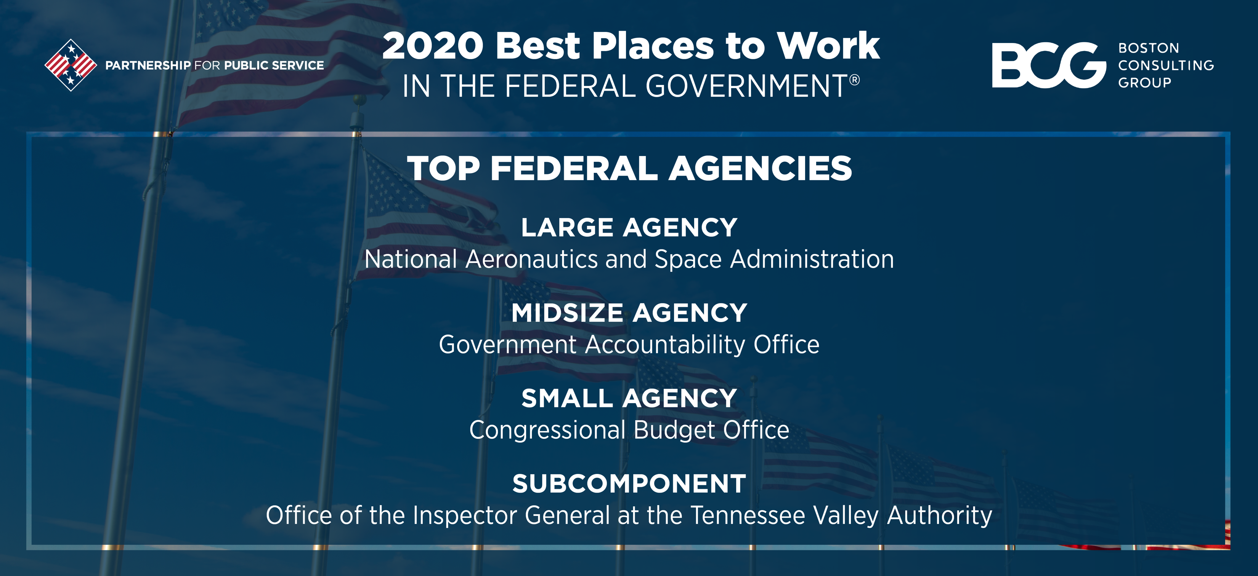

Slide 23

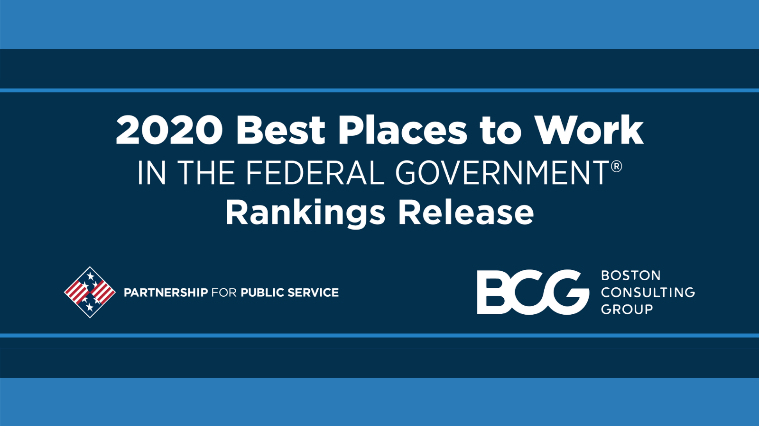

Slide 24
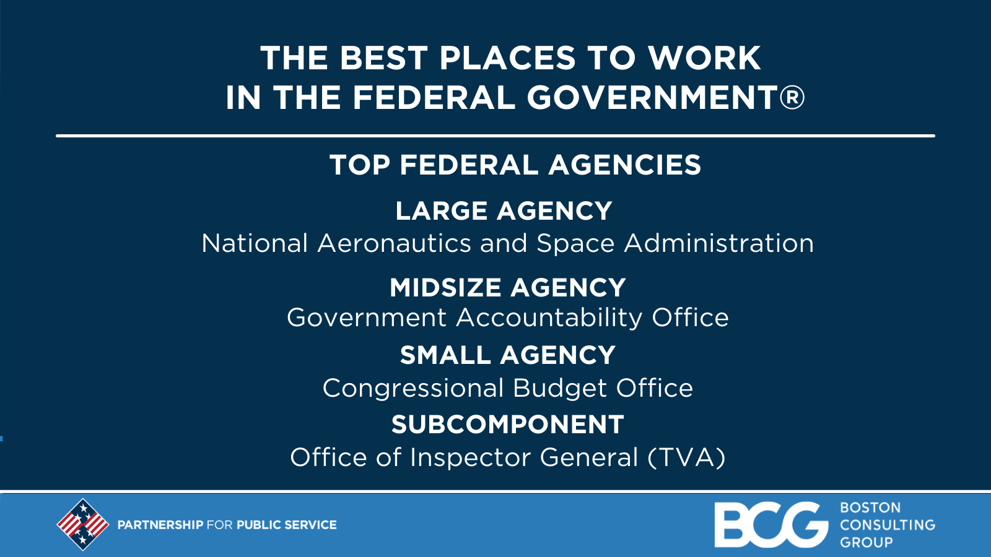
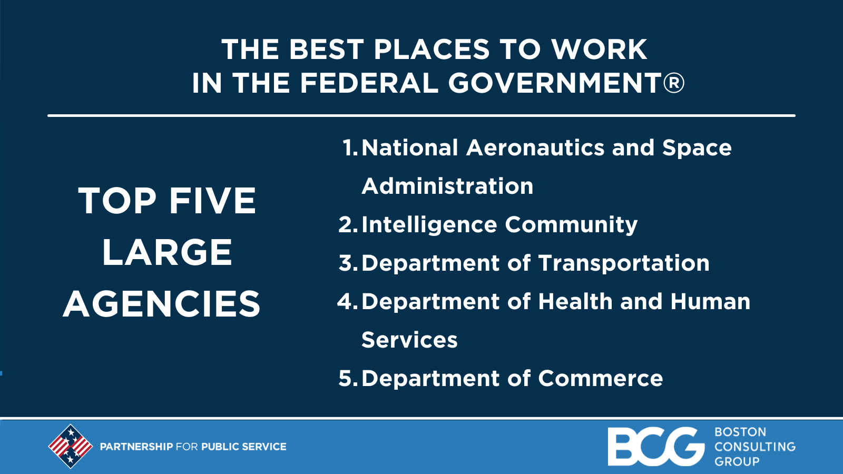
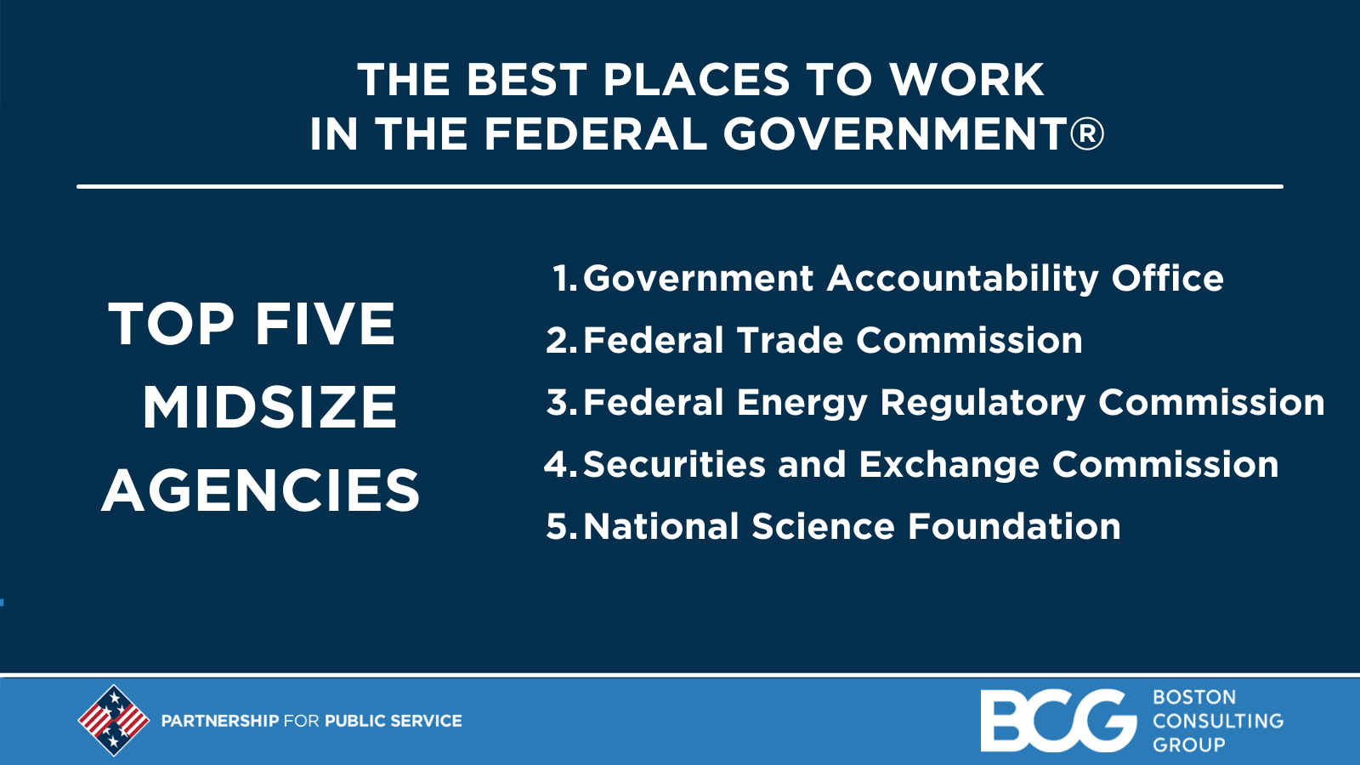
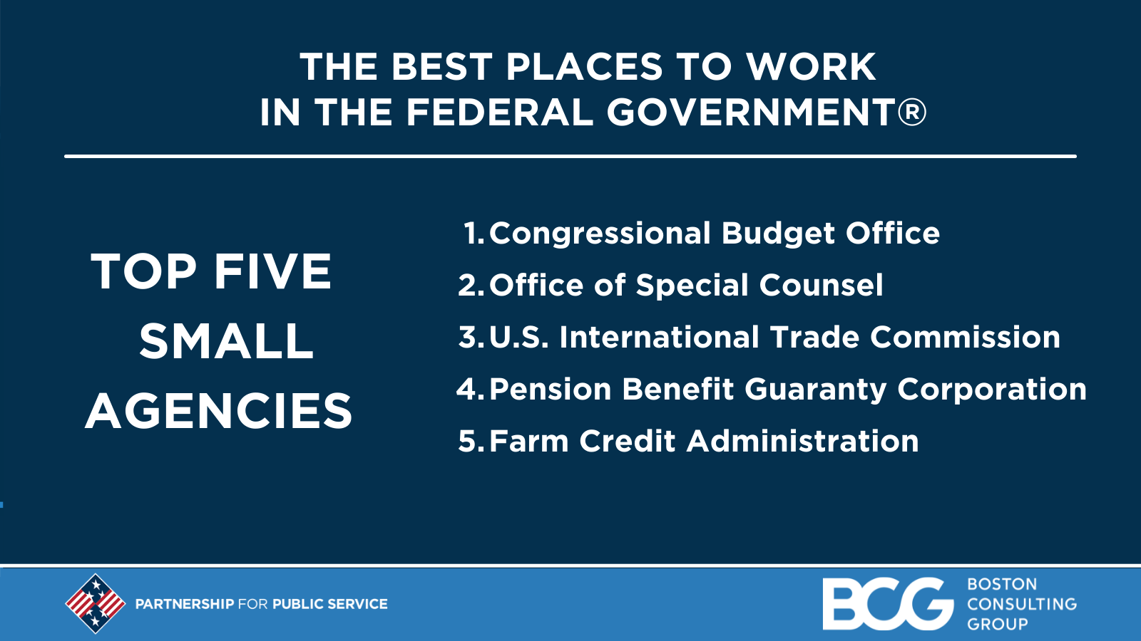

Slide 25
